Slide 1

One-Way ANOVA
Reading: 5.1 – 5.4
exercises: Ch 5. 27, 37-38, 40
Assigned: hw 10
Producer: dr. mario
img credit: alex riegert-waters

Slide 2
ANOVA
Usage of ANOVA
Numerical Response Variable (Y)
Categorical Predictor Variable (X)
Questions to Answer:
Do different groups have different means?
How different are the means across groups?
One-Way ANOVA Implies There is One Predictor Variable

Slide 3
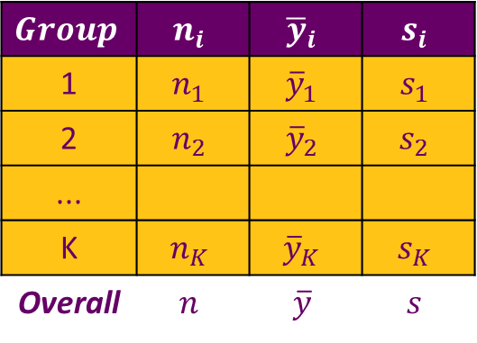
ANOVA
Data: Samples from Different Groups (K = # of Groups)
Summary Statistics
Test Hypotheses
$$Group$$ | $$n_{i}$$ | $${\overline{y}}_{i}$$ | $$s_{i}$$
1 | $$n_{1}$$ | $${\overline{y}}_{1}$$ | $$s_{1}$$
2 | $$n_{2}$$ | $${\overline{y}}_{2}$$ | $$s_{2}$$
...
K | $$n_{K}$$ | $${\overline{y}}_{K}$$ | $$s_{K}$$
Overall | $$n$$ | $$\overline{y}$$ | $$s$$
$H_{0}:μ_{1}=μ_{2}=⋯=μ_{K}$ vs. $H_{a}:Some μ_{i}≠μ_{j}$

Slide 4
Example: Grades on Different Exams
There are Four Different Exams (1, 2, 3, 4)
There are Five Students (Barb, Betsy, Bill, Bob, Bud)
Each Student Takes All Four Exams
Question: Is there a significant difference in the average grade among the four different exams?

Slide 5
Supplement for Lecture 22
Fit Multiple Models
Perform Nested F-Test
Perform Cross Validation

Slide 6
“Cross-Validation”
All Previous Metrics are Based on Fitted Values
We May Want to Consider Metrics Based on Predicted Values
To Get Real Predictions We Have to Leave Data Out of Model Fitting
Cross-Validation Methods Involve the Intentional Leaving-out of Data to Evaluate How Accurately a Model Would Predict Out-of-Sample

Slide 7

“Cross-Validation”
Holdout-Method (Simplest form of Cross-Validation)
Split Data Into Training and Test Sets
Fit Models to Training Set
Predict onto Test Set
Evaluate Prediction Accuracy Using Metric (i.e. RMSE)
Compare RMSE in Training Set to RMSE in Testing Set
$$RMSE=\sqrt{\frac{∑{\left(y−\hat{y}\right)}^{2}}{n}}$$
Notice We Are Not Dividing by n-1

Slide 8

“Cross-Validation”
Shrinkage is the Difference Between R-squared from the Model and R-squared Calculated on Predictions from Test Set
You can Use the Correlation Between $Y$ and $\hat{Y}$ to Calculate Out-of-Sample R-squared
Book Says Shrinkage of More Than 50% is “Worrisome”
Should We Expect Shrinkage? What Does It Attempt to Measure?

Slide 9
Conclusion
Cross-Validation Methodology in the Textbook is Obsolete
What are the Problems with the Holdout Method?
Personally, I Wouldn’t Call What We Learned Cross-Validation
Classic Cross-Validation is Called K-Fold Cross-Validation

Slide 10
Thank You
Make Reasonable Decisions

